Slide 1

CROP YIELD PREDICTION USING MACHINE LEARNING ALGORITHM
UNDER THE GUIDENCE OF : PRESENTEES :
Dr . M Vamsi KRISHNA AKHILA NAGULA -18RJ1A05G0
SHIVA BAIKANI -18RJ1A05J1
VAISHNAV KRISHNA -18RJ1A05E2

Slide 2
contents
Abstract
Introduction
Existing system
Disadvantages
Proposed system
Advantages
System requirements
System Architecture

Slide 3
ABSTRACT
Agriculture is one of the major and the least paid occupation in India.
Machine learning can bring a boom in the agriculture field by changing the income scenario through growing the optimum crop.
It focuses on predicting the yield of the crop by applying various machine learning techniques. The outcome of these techniques is compared on the basis of mean absolute error.
The prediction made by machine learning algorithms will help the farmers to decide which crop to grow to get the maximum yield by considering factors like temperature, rainfall, area, etc.

Slide 4
INTRODUCTION
Agriculture is considered as the main and the foremost culture practiced in India.
Since there are invention of new innovative technologies and techniques but its not getting used properly in agriculture field.
Now a days, some farmers don’t have awareness about the crop which suits their soils as per soil quality, soil nutrients and soil composition. Depending upon these parameters they may choose a crop which will not give them as expected production rate. Hence, some of the farmers chooses the suicide over it for paying off the loan which is not surely the right solution for it.

Slide 5
EXISTING SYSTEM
In existing system farmers not connected with any technology and analysis.
In traditional system farmers uses “trail and error” method. Farmer experiments on land with different crops, water availability, etc. and after many such “tries”, farmer probably gets the crop production as expected.
There are many review papers on crop yield prediction. But no such system exists as of now.

Slide 6
DISADVANTAGES
High chance of time and money loss.
Particularly when growing new crops, farmers may face risks of either market failure or production problems.
There exist high uncertainty about the crop yield.

Slide 7
PROPOSED SYSTEM
We proposed a crop yield prediction system that will predict the production of the crop depending on past data.
Crop yield prediction is the concept which is used to help farmers by providing them information about crop production.
Using the different algorithms of machine learning data analysis is done in efficient manner.

Slide 8
ADVANTAGES
System is extremely useful for farmers.
The main advantage of using this application is that farmers can get the idea about the crop production based on which they can plan their farming activity and market income expectations.
Industry can benefit from yield predictions by better planning the logistics of their business.
Simple and easy to install and configure.
Most of the technologies utilized in this project are available freely.

Slide 9
SYSTEM REQUIREMENTS
SOFTWARE REQUIREMENTS
Operating System : Windows XP
Programming Language : Python
HARDWARE REQUIREMENTS
RAM : 512Mb.
Processor : AMD Dual core processor
Hard Disk : 500GB Minimum
Monitor : 15 VGA color

Slide 10
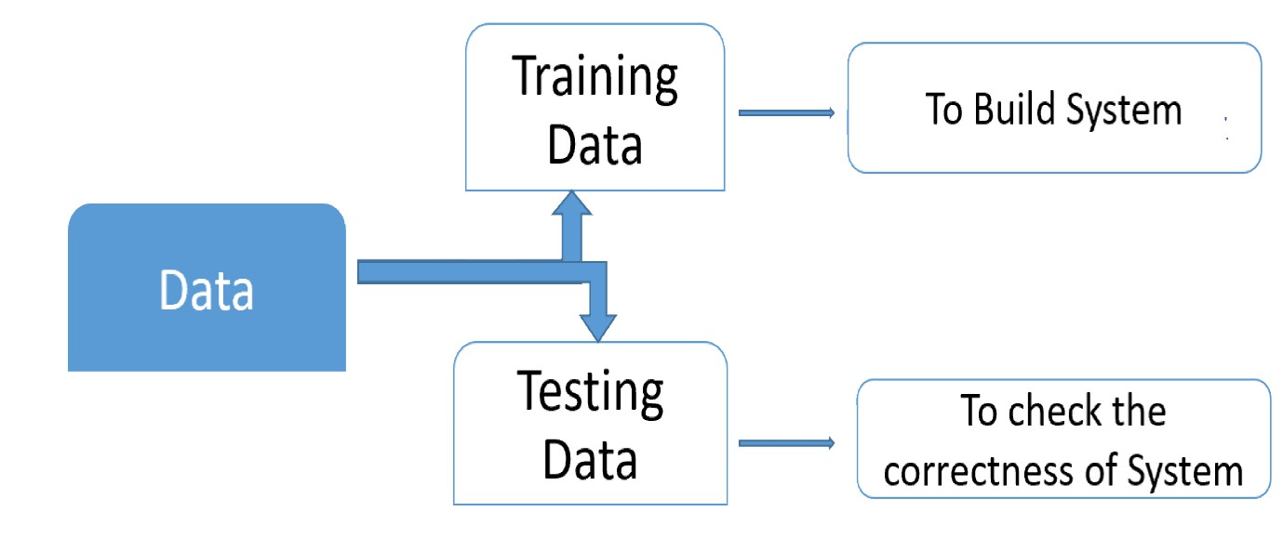
SYSTEM ARCHITECTURE

Slide 11
THANK YOU

